Slide 1
Vandeane Smith 凡丁 (M202261029) Sangeen Khan 可汗 (M202261028) Group 2
Department of Communications Engineering
School of Computer and Communication Engineering
USTB

Slide 2
6G Networks and Modern Security Challenges and Solutions
Why 6G?
Need for privacy in 6G.
Security Threats
Security Solutions

Slide 3
Need for 6G
The applications of 5G are still under development.
People are working on the full usage of 5G technology.
Limitations are uncovered due to data-centric procedures.
The Internet of Things and Internet of Everything.
The AI-based edge intelligence.

Slide 4
Why security in 6G matters?
1G
Voice Calling
2G
Text Message
3G
Internet Access
4G
5G
6G
Internet of Applications
Internet of Things
Internet of Everything
Figure 1 Evolution of 6G
Mohsan, S. A. H., Mazinani, A., Malik, W., Younas, I., Qasem, N., Amjad, H., & Mahmood, A. (2020). 6G: Envisioning the Key Technologies, Applications and Challenges. International Journal of Advanced Computer Science Applications, 11.

Slide 5
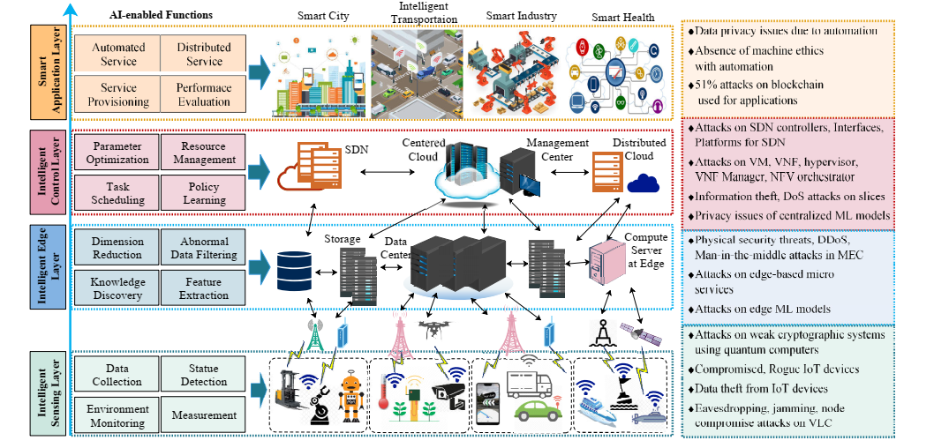
Security Threats
Figure 2 Security Challenges in 6G
Siriwardhana, Y., Porambage, P., Liyanage, M., & Ylianttila, M. (2021). AI and 6G security: Opportunities and challenges. Paper presented at the 2021 Joint European Conference on Networks and Communications & 6G Summit (EuCNC/6G Summit).

Slide 6
Modern Solutions for privacy in 6G
Federated Learning
Block-chain
Homomorphic Encryption
Multi-Party Computation

Slide 7
Federated Learning
The end nodes can train the local models based on the collected data.
After the training process, the local models are shared with the base station.
The actual data is not transferred via a network.
Yang, Z., Chen, M., Wong, K.-K., Poor, H. V., & Cui, S. (2021). Federated learning for 6G: Applications, challenges, and opportunities. Engineering.

Slide 8
Federated Learning
Figure 3 Federated Learning
Fu, A., Zhang, X., Xiong, N., Gao, Y., Wang, H., & Zhang, J. (2020). VFL: a verifiable federated learning with privacy-preserving for big data in industrial IoT. IEEE Transactions on Industrial Informatics.

Slide 9
Challenges in FL
Communication Issues
Privacy Issues
Real-time services

Slide 10
Blockchain
A decentralized and distributed network of nodes.
Information are stored in the distributed blocks with the digital signatures.
Figure 4 Working of Blockchain
Shah, K., Chadotra, S., Tanwar, S., Gupta, R., & Kumar, N. (2022). Blockchain for IoV in 6G environment: review solutions and challenges. Cluster Computing, 1-29.

Slide 11
Advantages
Nodes authentication.
High transparency.
Prevent DDos attacks.
Tamper-proofing can be restricted.

Slide 12
Concerns by using BC
Limitation of storage.
Scalability.
Processing time.
Uddin, M. A., Stranieri, A., Gondal, I., & Balasubramanian, V. (2021). A survey on the adoption of blockchain in IoT: challenges and solutions. Blockchain: Research and Applications, 2(2), 100006. doi:https://doi.org/10.1016/j.bcra.2021.100006

Slide 13
Homomorphic Encryption
Allows the operations on the encrypted text without disclosing the original data.
Very efficient to be used for privacy-preserving computing.
Integration of FL and HE.
Sav, S., Pyrgelis, A., Troncoso-Pastoriza, J. R., Froelicher, D., Bossuat, J.-P., Sousa, J. S., & Hubaux, J.-P. (2020). POSEIDON: Privacy-preserving federated neural network learning. arXiv preprint arXiv:.00349.

Slide 14
Working of HE
1: User encrypt message.
Enc (m).
4: Evaluation of f() homomorphically
2: Enc (m) shared with server
3: User requests, f().
5: Server response. Enc (f(m))
6: User compute.
Dec (Enc (f(m))).
Figure 5 Working of HE
Shrestha, R., & Kim, S. (2019). Chapter Ten - Integration of IoT with blockchain and homomorphic encryption: Challenging issues and opportunities. In S. Kim, G. C. Deka, & P. Zhang (Eds.), Advances in Computers (Vol. 115, pp. 293-331): Elsevier.

Slide 15
Issues with HE
Inference attacks
Computational power.
Computational time.
Abreu, Z., & Pereira, L. (2022). Privacy protection in smart meters using homomorphic encryption: An overview. Wiley Interdisciplinary Reviews: Data Mining Knowledge Discovery, 12(4), e1469.

Slide 16
Multi-Party Computation
Give a group of parties the ability to jointly compute secure functions over their private inputs while imposing a certain security guarantee during the computation.
Company A
Results Obtained
Company B
Function Calculator
Company C
Figure 6 MPC Overview
Resende, A., Railsback, D., Dowsley, R., Nascimento, A. C., & Aranha, D. F. (2022). Fast privacy-preserving text classification based on secure multiparty computation. IEEE Transactions on Information Forensics Security, 17, 428-442.

Slide 17
Any Questions ?
Without questions, there is no learning – “W. Edwards Deming”.

Slide 18
Thank you !
For being a wonderful audience.

